Slide 1
The Evolution of a Transformation
Mary Sue Daniel and Sarah Thomas,
Irving Schools Foundation Board Members
Notes:
Who you are, what you do for a living, why you joined ISF.
Ice Breaker

Slide 2
Agenda
Evaluation of the 3 P’s:
Programs
People
Processes
Notes:
Evaluation of the 3 P’s:
Programs- how to create, evaluate and grow your programs to meet the ever changing needs of your students
People- having the right staff and board members “on the bus”
Processes (strategic plan for board and staff)

Slide 3
Introduction
As a 30 plus year old organization, we realized that we had become stagnant. While it was not intentional, it is something that can happen overnight, and you won’t even realize it’s happening.

Slide 4
What does the Irving Schools Foundation do?
Our Mission
The Irving Schools Foundation provides financial resources to maximize educational opportunities for teachers and students in Irving ISD by funding innovative programs, scholarships, and activities that enhance creativity, leadership, and academic success.
Notes:
The History of the Irving Schools Foundation:
-Established in 1985. One of the first Foundations in the nation
-Originally established to help teachers pay for conferences
-Evolved as a community over the years 12% Free and reduced lunch in 1985 versus 100% now- our mission is to serve the “whole child”
Programs/People and Processes evolved over time- we will be reviewing the last 10 years

Slide 5
The population we serve
Students: 33,552
Teachers: 2,295
Campuses: 37
District Square Miles: 45.7
Representing 96 countries and 56 languages
100% of our students grades K-8 receive free lunch
95% graduation rate
Notes:
SURVEY THE AUDIENCE- talk about how we will scale our presentation
Read through bullet points:
Students: 33,552
Teachers: 2295 – some people are surprised that we serve teachers too
Campuses: 37
District Square Miles: 45.7
Representing 96 countries and 56 languages- one of the most diverse school districts in the nation- lots of resources needed to help parents
100% of our students grades K-8 receive free lunch- explain this program
95% graduation rate –average in Texas is 89.1 and the national is 84.1%. Kids are excelling even though they come from difficult backgrounds
-talk about the graduation rate and overcoming the odds- Sara Escobar’s story

Slide 6
Evaluation of the 3 P’s
PROGRAMS

Slide 7
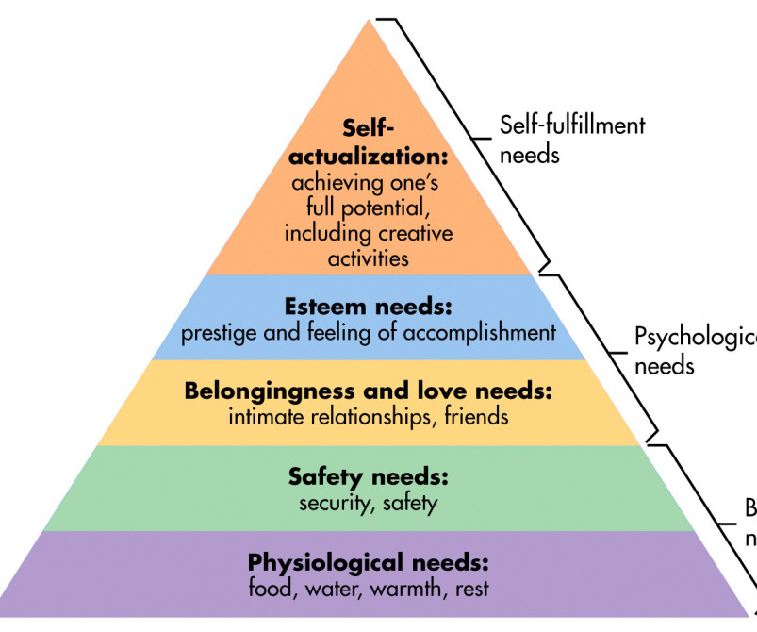
The assistance we provide
Social and Emotional Assistance
Basic Human Needs
Educational Resources and Assistance
Notes:
Self Actualization- scholarships (we started with this and realized we needed the foundation)
Physiological needs- FFT, Operation Warm (partnership with Operation Warm), Uniforms
Safety Needs- Anti Bullying and Spark Tank Story (student being jumped into a gang)
Belongingness and love needs- Girls on the Run example (all of our extracurricular activities that we offer through Spark Tank). Caring and Sharing. Incentives from Bioworld for morale boosters)
Esteem needs- Supplies for Success, Spark Tank (real life skills- builds confidence, belief in each other as a team), FFT (remove food insecurity). Student Ambassadors program.
How do we bridge the gap between this pyramid and what we are actually doing?

Slide 8
The Importance of Evaluation, Surveys and Listening to Your Constituents
Conduct an annual evaluation of all your programs
The importance of data collection and evaluation (scholarships- allow for other expenses. Surveys: donors, recipients, board members, staff members, school leadership
Site visits: see your dollars at work
Counselors are your best friends Don’t be afraid to make changes fast and often!
Notes:
Conduct an annual evaluation of all of your programs
In 2012, we had 57% of our students claiming our scholarships ($177,550 awarded and $102,856 claimed)- for a variety of reasons. In 2021, we saw that number jump to over 80%. How? We adapted our scholarships to meet our students’ needs. We let them spend the funds on things they actually need: laptops, calculators, art supplies and we mentor and coach the students along the way. Adapt your programs to fit YOUR kids- cautionary tale of what we did before Spark Tank: gave money to schools because we read some article that said that it would be good for our kids. We were trying to fit a square peg into a round hole.
We called the counselors and principals
You could do this electronically- they are busy- they won’t answer. In person helps build the relationships. School visits are so important!
EGC Visits- tell them about our programs
Spark Tank example- informal survey- how this led to the creation of all our other programs
-Anti-bullying
-C2C store (when we started we had X versus now)
Scholarship claim rate- get these numbers
Don’t be afraid to make changes fast and often!
Food for Thought story (where we started to where we are now- partnership with the food bank. Very grass roots.)
How many grants we have given through Spark Tank, total dollars and how many people we have affected. Include EEG as well. 2012 versus 2019.
Talk about COVID- Sarah- the blessings of COVID. Allowed us to get the warehouse to set us up for success.

Slide 9
The Evolution of our Programs
2013
Spark Tank was created in May
2016
Caring and Sharing is created in order to show our kids “love”
2017
C2C Store is created as a result of Spark Tank requests.
2018
2019
Food for Thought is born
Anti-Bullying Campaign is launched as a result of a Spark Tank presentation

Slide 10
Educational Resources and Assistance
Notes:
Issue in 2017 with bullying and suicide.
In partnership with Irving ISD, it was the goal of Irving Schools Foundation to provide resources that allowed the 2019 "Irving ISD is Kind" Campaign (Anti-Bullying Campaign) to be successful across the District.
2616 7th graders participated

Slide 11
Grants to Schools
SPARK TANK!
TEACHER OF THE YEAR AWARDS
Notes:
What is Spark Tank:
This grant program gives teachers and students the opportunity to seek funding for projects or opportunities in their classrooms. Presentations are given to the Programs Committee monthly. No restrictions on how much to ask for.
Why we created it- give students the opportunity to advocate for themselves, work together on a project and work on their presentation skills. Gives us the opportunity to have our finger on the pulse of the schools.
Two of my favorite:
-Debate Club story
-Missing Arm Cello- meet the students where they are. Professor had a design.
2019/2020 $ amount of spark tank grants $279,505.82; $36,667 awarded in 2013
Employee Enrichment Grants:
Offered every month; $1000 maximum; anyone can apply.
Many of our teachers go on their personal time during the summer or weekends or evenings.
We pay for GEDs, ESL courses and HVAC, etc.
2019/2020 $ amount of EEGs $32,515
Teacher of the Year Awards:
The gifts they receive, the event.

Slide 12
2021 Scholarships
Awarded 234 scholarships to high school seniors, IISD staff and teachers
$435,000 was awarded to this year’s recipients
65% of our students are first generation college students
Notes:
Started awarding scholarships in 1987
Teachers and staff get scholarships too- Mention Magda starting as a Para and working her way up- growing our own
First generation- mention Jimmy’s story
Volunteer opportunity- mentorship
Breakfast with the Stars

Slide 13
Social and Emotional Assistance

Slide 14
Irving ISD Is Kind
Notes:
Issue in 2017 with bullying and suicide.
In partnership with Irving ISD, it was the goal of Irving Schools Foundation to provide resources that allowed the 2019 "Irving ISD is Kind" Campaign (Anti-Bullying Campaign) to be successful across the District.
2616 7th graders participated
2022: International Stand Up to Bullying Day on February 25, Mental Health Parenting Seminars, Bringing Back Irving ISD is Kind in the fall.

Slide 15
Basic Human Needs

Slide 16
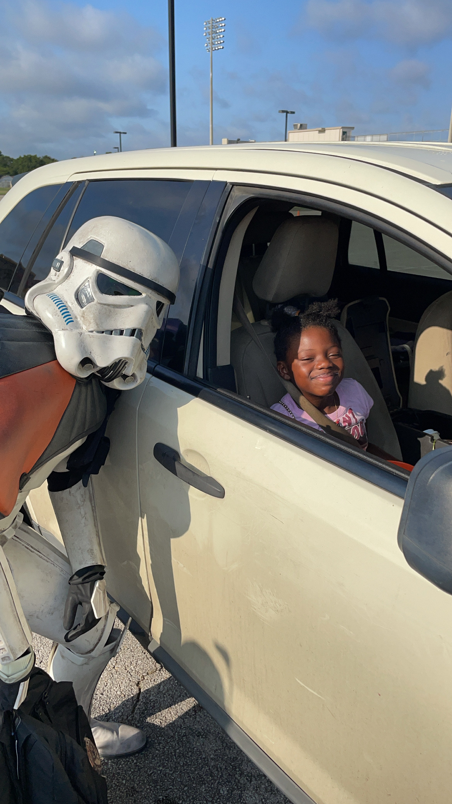
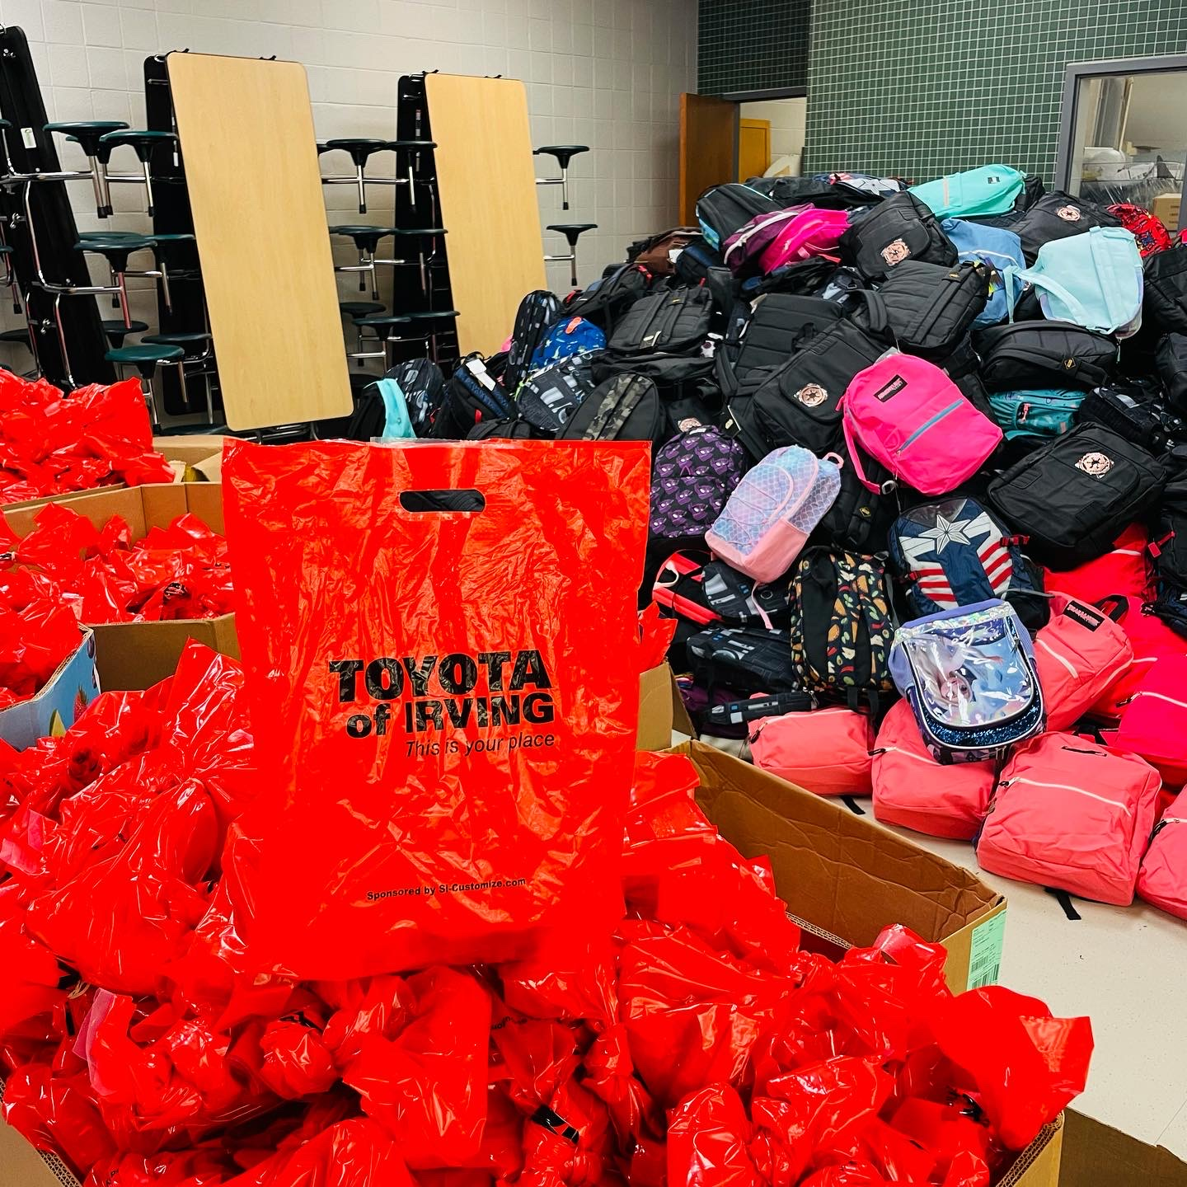
2021 Results
2021 Results
3,196 backpacks given at live event
Over 1,500 backpacks given to schools
$57,000+ in Sponsorships
$30,000+ in In-Kind Donations
200+ Volunteers
205 immunizations for 80 families
327 Covid-19 Vaccines
Notes:
Walk through the day- what the kids normally receive at the event.
2020 Program
-how COVID has changed the program

Slide 17
The store without a cash register – for Irving staff to get FREE supplies throughout the year. Free school supplies, backpacks and uniforms are just some of the items offered!
What kind of help do we receive?
Financial Contributions
New or gently used school and office supplies.
New or gently used coats and school uniforms.
Notes:
336 “Customers” – 2019 151 “Customers” - 2020
301 Volunteer hours -2019 194 Volunteer hours- 2020
27,111 supplies – 2019 4,267 supplies - 2020

Slide 18
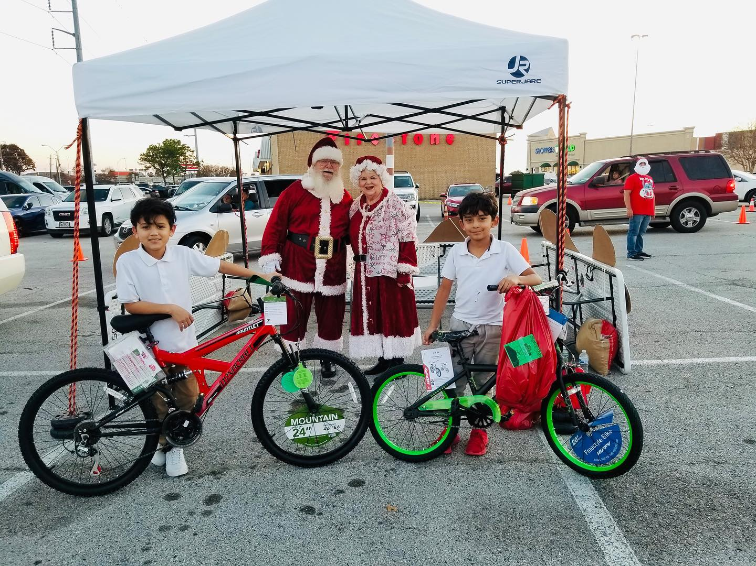
Notes:
Caring & Sharing
The ornament that the young boy completed
5 programs benefitted
Home Instruction for Parents of Preschool Youngsters
Migrant Students
Newcomer Academy
Teenage Pregnant and Parenting Students
Program Assisting Students in School
342 students served
Drive thru event with 150 cars- received meal kits, cookies and goodie bags along with their presents
Generally teens ask for bedsheets and towels, kids love bikes!

Slide 19
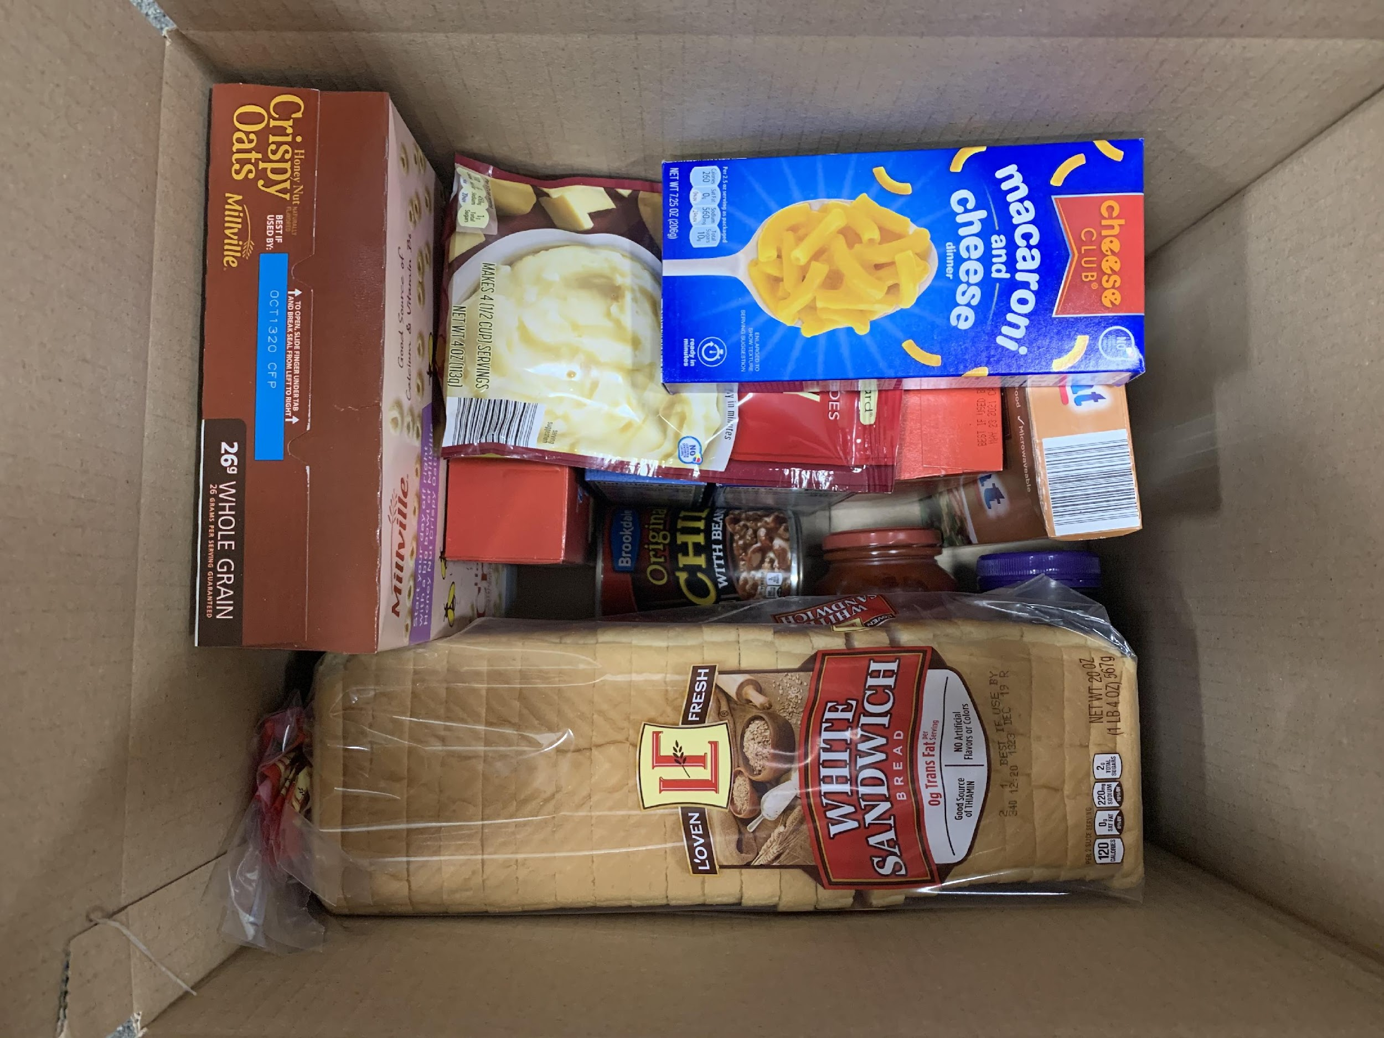
What’s for Supper?
In the 2021, our Food for Thought Program provided 34,446 weekend food bags and holiday gift cards for our students
We currently serve 33 campuses and an average of 1,200 food bags each week throughout the school year.
Notes:
The story of how Food For Thought was created- the little boy “Nick”

Slide 20
Evaluation of the 3 P’s
PEOPLE
Notes:
Sarah- give story about never serving on a board before.

Slide 21
Customers (donors) will never love a company (cause) until the employees (and board members) love it first.
Simon Sinek, author, Start with Why (adapted by ISF)
Notes:
Creating the culture you want:
Staff
-Don’t hire staff for their talent, hire them for their passion. You can train them on the other parts.
-Don’t be afraid to fire fast and fire often if they are not the right fit- toxic people make for toxic results.
-Grow your own: our intern story (Emily story)- the glory without the story. We were the 1 person office just 10 years ago. Elder Macias story (churches do mission trips overseas- do it here). Gwen Craig (works 3 days a week- retired teachers are a great resource)
NEW SLIDE FOR BOARD
Board
-Have job descriptions with expectations
-formalized the application process for committees and board. Committees are a pipeline now. Must be sponsored by someone. Helps in the vetting process. We then interview and evaluate. Don’t be afraid to say no to people. Cut the dead weight. What do you do when it doesn’t work out.
-Hold people accountable
-Conduct a board retreat for all board members annual; conduct new board member orientation for new people.
-ED and Board Leadership should ”Date” your board members- go to lunch with them, learn about their passions, invest in them because they will invest in your organization
-we make all of our board members join spark tank- tug at their hearts

Slide 22
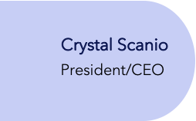
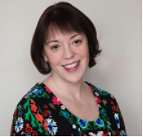
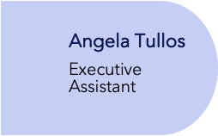
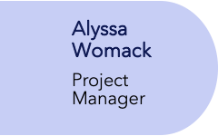
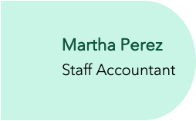
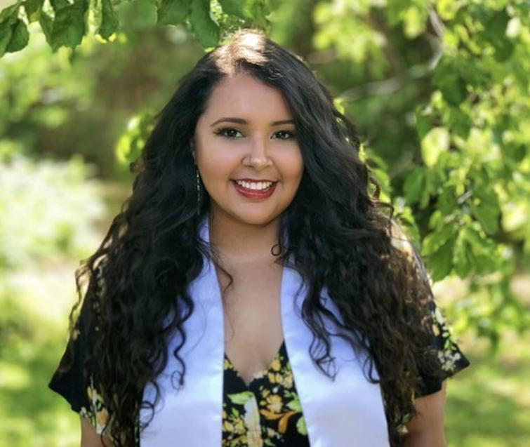
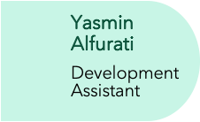
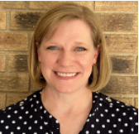
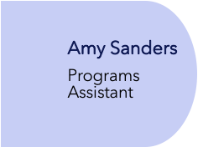
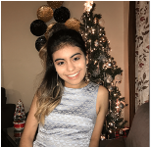
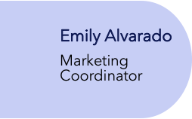
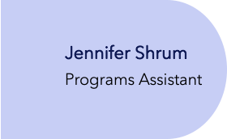
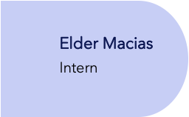
ISF Organizational Chart
2012
2013
2014
2021
2021
2020
2019
2021
2021
Notes:
There is a 4 second delay between the transitions- YOU DO NOT NEED TO CLICK

Slide 23
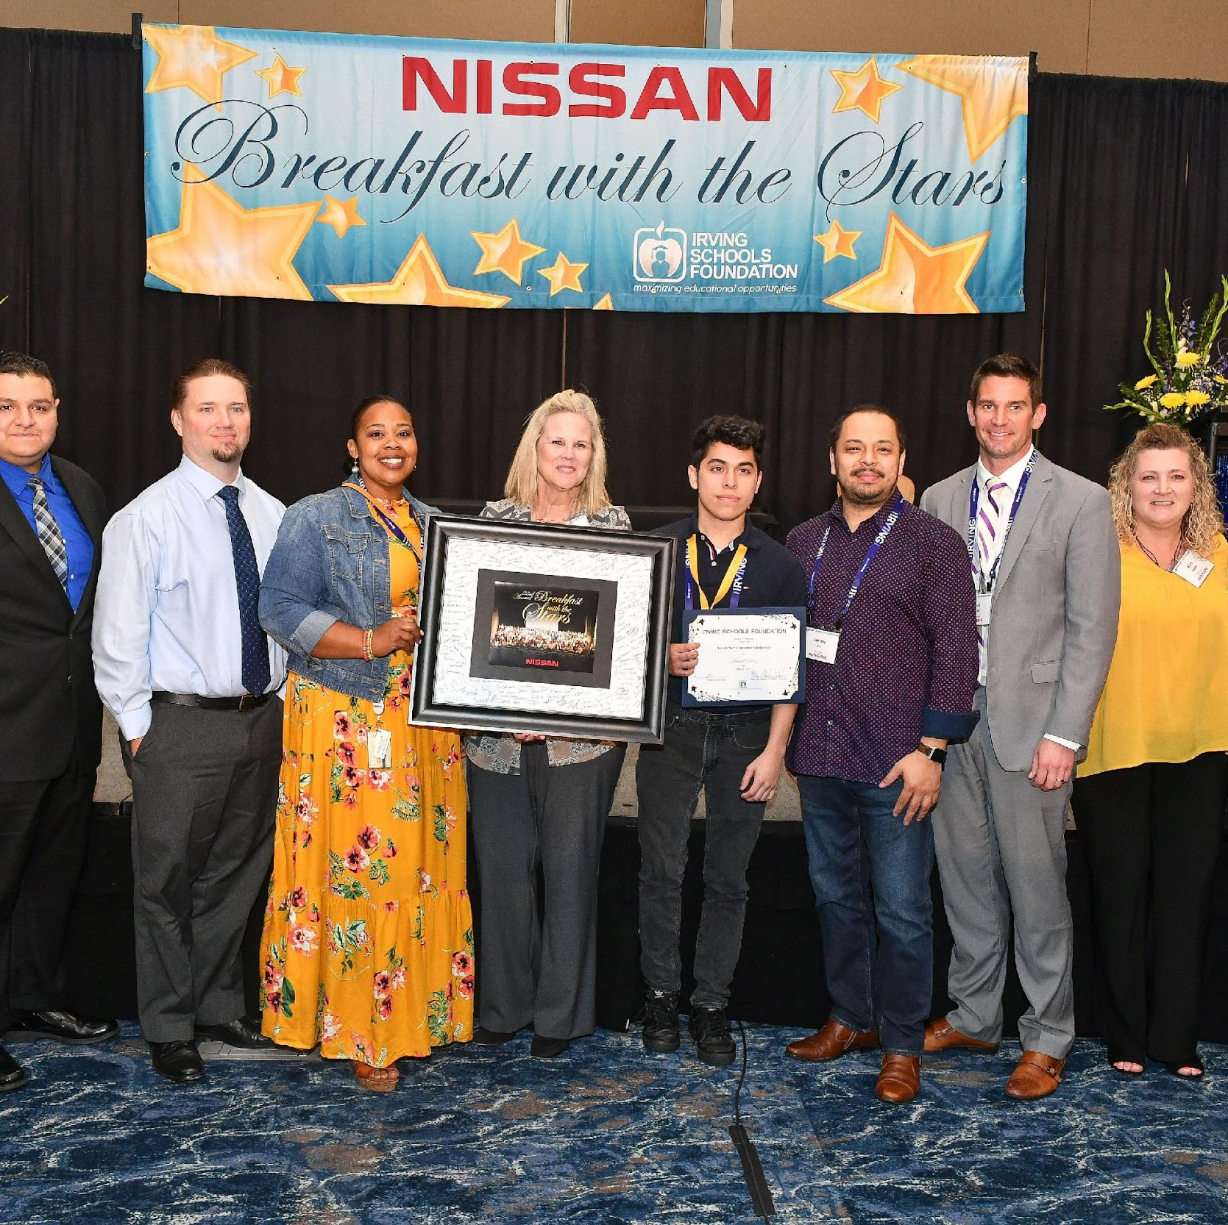
How to Create an Engaged Board
Notes:
Board
-Have job descriptions with expectations
-formalized the application process for committees and board. Committees are a pipeline now. Must be sponsored by someone. Helps in the vetting process. We then interview and evaluate. Don’t be afraid to say no to people. Cut the dead weight. What do you do when it doesn’t work out.
-Hold people accountable
-Conduct a board retreat for all board members annual; conduct new board member orientation for new people.
-ED and Board Leadership should ”Date” your board members- go to lunch with them, learn about their passions, invest in them because they will invest in your organization
-we make all of our board members join spark tank- tug at their hearts

Slide 24
Evaluation of the 3 P’s
PROCESSES
Notes:
Strategic Planning- Vision statement, mission statement, dream statement (dream big: warehouse)
Blessing of COVID to help us evaluate and improve efficiencies
Have the board give input. Be honest with your board. Have the engaged board. ED needs to feel comfortable telling the board everything. Use the board as a sounding board with hiring.
Executive Coach was a huge help- helped the ED open up, work on staff and build a strong board. Building the right Executive Committee (you have to trust them). – strategic and focused on building the right board (finance people, development).
Strategic Partnerships: Car dealers, donors, school district (if we don’t know what their mission is then we are nowhere. We might be slightly different. Need to have buy in with Sup. Use Randy as an example (he sits on Spark Tank and on School Board. He has taken things back to the District to help.
We create awareness. More relationships with others besides Sup (MOU in place because things change and it could happen every 2 years- need to protect mission and goal), other NPs.
Accounting firm, Audit firm, Software- always evaluate and make sure you have other vendors in the queue.
Run this like a business- have board bring skills from their employment/background. We can tap into that. Our students are our clients. HR, Finance, Shannon story (compliance officer doing fundraising)- board training on how they can put their skills to use. Sarah tell story about calling Shannon about development.
Bring your staff IN- transformation story about how staff was always left out of decisions. Now they come to board meetings, participate in board retreats and strategic planning sessions. They feel like they are part of the decision- board members have other people they are comfortable going to.
-Conduct weekly staff meetings (no matter how small you are)
-Staff Development- do lunches for birthdays and show them you appreciate them (schedule out once a quarter)
In particular, we have observed four ways that nonprofit leaders can take action that influence behavior. Three of the ways will seem familiar to most any organization.
Make sure that you have the right people on board and that they receive the support they need to do their work well (training)
Use performance assessment systems to set clear expectations for people and to give them feedback when they are or are not on track. (formal job descriptions- everyone knows their marching orders)
Clarify decision-making processes, establishing who will define the rules of the road that will guide the focus and actions of the organization.
To these, however, we add a fourth, which in the case of nonprofits can inspire employees to change their behavior.
Use personal communication from the executive director to appeal to employees’ passion for the cause they signed up for ―the organization’s mission and vision―and demonstrate how specific changes in their behaviors will enable the organization to achieve its goals. (Bridgespan.org)

Slide 25
Summary
Notes:
Change- don’t be afraid of change. Just because you have done something one way forever. Listen to board, students, teachers. Doesn’t matter your size- be open to change. Don’t be afraid to make changes often!

Slide 26
Thank You
Mary Sue Daniel and Sarah Thomas
isf@irvingisd.net
www.irvingschoolsfoundation.org

