Slide 1
Elevating the Relationship Between Education Foundations and Districts for the Greatest Student Impact
Valerie Foster, CEFL Executive Director
Sanger Education Foundation
Judy Geelhoed, Executive Director
San Antonio ISD Foundation
Allison Miller, Executive Director
Frisco Education Foundation

Slide 2
Elevating… it’s a different level of thinking
Beyond teacher grants and scholarships, education foundations can play a significant role in helping to bring in and steward partners/investors to support strategic initiatives to benefit students at the school and District level that otherwise might not be possible. These partnerships are varied and must be designed to meet the unique needs of the students in the local community and match donor values.
Notes:
Often in response to workforce development, community needs and/or strategies to improve low performing schools, Education Foundations can develop partnerships and facilitate philanthropic investments that help districts implement new programs to meet their goals.

Slide 3
Assets of Education Foundations
Focus on the Donor/Partner/Investor
Managing Donations with Restrictions
Donor Stewardship (not just reporting)
Financial Accountability/Transparency
Articulating ROI in Donor Language (including student achievement results)
Relationship Building & Donor Cultivation
Ability to Accept and Manage Endowments
Soliciting & Managing Estate & Beneficiary Gifts
Bridging District Funding/Budget Gaps
Nimble & Responsive to Community & District Needs
External Voice Telling the District’s Story
Notes:
Foundations have the ability to track, cultivate, solicit and acknowledge supporters/partners through peer to peer and personal relationships. EF’s have robust accounting and transparency in all aspects of governance. They have the ability to create and develop Endowments through either outside or internal management as dictated by their policies and procedures. Depending on their Finance and gift acceptance policies can received beneficiary designations, and estate legacy gifts. As district’s grow or if they encounter a disaster, specific challenge or sudden need, Foundations have the ability to be responsive. Most of all Foundations being independent can tell the district’s story, are ambassadors for the district, advocate on behalf of the district and build community support through their work in recognizing the districts academic success.

Slide 4
Assets of School District & Foundation Partnership
School District:
Instructional Program Management
Qualified Staff
Student Level & District Data
Purchasing & Inventory Management Systems
Education Foundation:
Sharing Compelling Stories
Consistent Communication with Stakeholders
Guiding Donations/Investments to Meet a District Need or Create an Opportunity for the District
Notes:
School Districts do these things well. Have the capacity of program management, have amazing staff, have lots and lots of data, and have stories to tell. The Partnership provides opportunities for districts to have direct and consistent communication with stakeholders. And lastly working with business partners foundation staff can often determine/guide donations to meet specific district needs or gaps in funding specific programs. Stronger Together. Continuity.

Slide 5
Private Donations
Donations with Restrictions:
Program or project based
Contractual agreement through an approved grant application or MOU
Has specific requirements, restrictions, documented outputs and outcomes
Can be multi-year commitment
Most often expected sustainability by the District
Donations without Restrictions (Unrestricted):
Often fundraising event or annual campaign driven
Usually, individual donors
The hardest and best gifts for and non-profit
Notes:
New GAP language Foundations have the ability to accept both types of financial support Donor Directed (Restricted) and without restrictions.
Unrestricted funds - speak to hard to come by. Emphasis on Private Funds not school funds, not federal funds but PRIVATE FUNDS therefore they are accounted different, documented differently, spent differently.
Valerie speak to memorial gifts

Slide 6
Partnership Accountability & Responsibility
Private funders want to be partners in creating a solution to a community and education problem (i.e., low college enrollment, lack of a workforce pipeline, students not entering kindergarten at grade level).
Programs can be changed over time and in partnership.
The primary responsibility of an education foundation (NPO) in accepting funds is to ensure donor intent and fulfill all agreed terms. Future gifts and your reputation depend on it.
Notes:
Not state or federal funds - look and feel different, are different. ROI’s for example, even the state is looking into ROI’s on career work force impact. Foundations have been gathering ROI, impact statements, documented outcomes and articulating back to supporters in many different formats. Newsletters, annual reports, posters, social media postings, donor receptions, and events. Fit a district need and foundation goal.

Slide 7
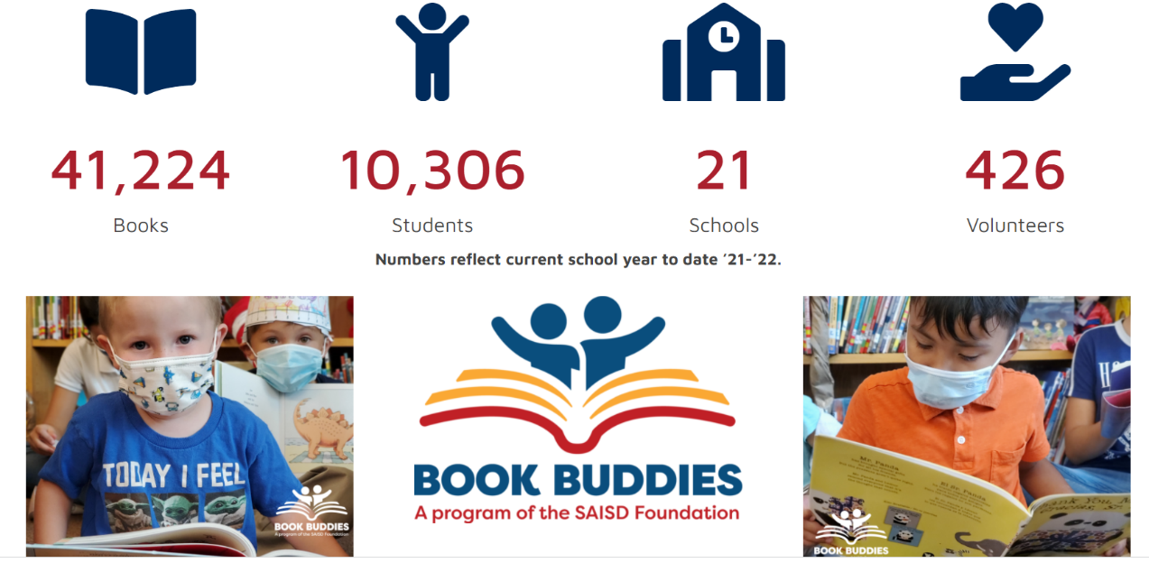
Partnership Accountability & Responsibility Cont.
Reported and observed ROI are important to the partner as well as agreed upon reporting, outputs and storytelling.
Private funds are built on a relationship of trust and regular communication.
Notes:
Not state or federal funds - look and feel different, are different. ROI’s for example, even the state is looking into ROI’s on career work force impact. Foundations have been gathering ROI, impact statements, documented outcomes and articulating back to supporters in many different formats. Newsletters, annual reports, posters, social media postings, donor receptions, and events. Fit a district need and foundation goal.

Slide 8
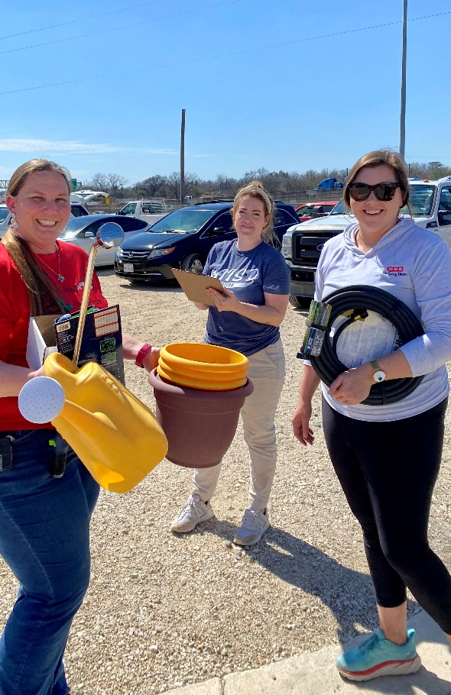
Building Relationships
Strategic Partnerships are all about building a partnership that:
Reaches a goal of your District
Supports a key value of the partner
Is in line with your Education Foundation’s mission/goals
Notes:
The ongoing, open and inclusive partnership with the district is vital in building these types of business partnerships and in general is an expectation of the local community.

Slide 9
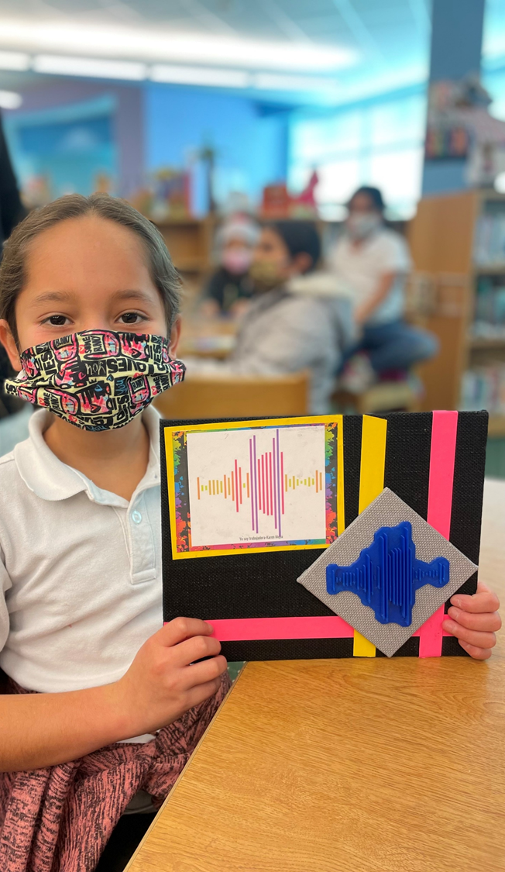
Sustainability & Stewardship
Provide one key contact
Make it easy
Do your homework to make the right request
Share stories and photos, not just data
Look for other ways to involve partners in your work
Relational not transactional

Slide 10
Questions?
Contact Judy at
jgeelhoed@saisdfoundation.com
Contact Valerie at
vfoster@sangereducationfoundation.org
Contact Allison at
MillerA@friscoisd.org

