Slide 1
please take
our money!
Mita Havlick
Randy Lewallyn
ADDRESSING THE
CURRENT TREND IN FUNDING
CAMPUS GRANTS
Karen Anderson

Slide 2
THE SESSION TOPIC
Since the onset of the pandemic school districts have faced staffing and many other challenges, and some Education Foundations have noticed a reduction in grant applications from campuses.
Let’s explore this topic and other factors that impact campus grants.
Mita Havlick
Randy Lewallyn
Karen Anderson

Slide 3
THE SESSION PLAN
PRESENTERS WILL SHARE THEIR PERSPECTIVE ON THE TOPIC.
ATTENDEES WILL HAVE THE OPPORTUNITY TO SHARE THEIR PERSPECTIVE ON THE TOPIC AND ASK QUESTIONS TO THE PANEL
Mita Havlick
Randy Lewallyn
Karen Anderson

Slide 4
NORMS
WHEN SHARING WITH THE GROUP, BE CONSIDERATE OF OTHERS. DON’T BE OFFENDED IF WE ASK YOU TO WRAP IT UP. TIME IS LIMITED.
DON’T GET DISTRACTED BY COMPARING YOUR GRANT PROCESS, SUCCESSES OR FAILURES TO OTHERS. WE ARE ALL DIFFERENT.
Mita Havlick
Randy Lewallyn
Karen Anderson

Slide 5
Red Oak ISD Education Foundation
Approx. 6000 Students / 5A
5 Elementary / 1 Middle / 1 High School
20th Year (2002-2022)
1 Full Time (with other district duties) / 1 Part-Time
Current Board of 19 Directors

Slide 6
History of ROISD EF Grant Program
50 % of Funds Raised go to Innovative Classroom Grants
Review Committee: Facilitator, 6 Directors, 2 Principals, 2 District Staff, School Board, and Director of Curriculum. Director of Technology attends for information purposes only.
Pre-Score, Discussion, Post Score – Minimum Score required to be awarded
$2000 Classroom Grants and $5000 Impact Grants
Transitioned to online only application 2021 – reduced application requirements

Slide 7
Analysis of ROISD Grant Program

Slide 8
Survey Results – “What did you not apply?”
I can't find the time to fill out all the paperwork and get my signatures.
Too restrictive. Maybe loosen guidelines.
Seems like a complicated process.
The writing of the proposal intimidates me.
Due to the monetary limit, what I would like to purchase is over the limit.
The grant application is
due during a very busy time
in the semester for me, and I haven't come up with an idea that I think will get funded.
Last time I applied, my application was denied.
Bad time of school year - too busy!
TIME!
Notes:
© Copyright PresentationGO.com – The free PowerPoint template library

Slide 9
Problems and Solutions
Largest obstacles for not submitting an application:
Time – lack of time, too busy, timing of application process
Intimidating – process too complicated
Grant amount too low
Previous denial of application
Immediate Solutions
Changed timing of process to Fall (from Spring)
Do a test mega grant – Hawk Hunt

Slide 10
Solution for 2021 Surplus
Two $10,000 Grants – one Elementary / one Secondary
Shark Tank Style
1 Minute Video Submission and short online form
6 Finalists Chosen to present to 3 judges – Live!
Allowed for things not normally funded in normal grant program
18 Applications accepted – 6 Finalists Chosen

Slide 11
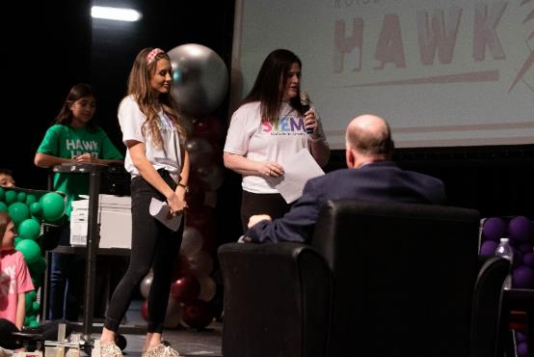
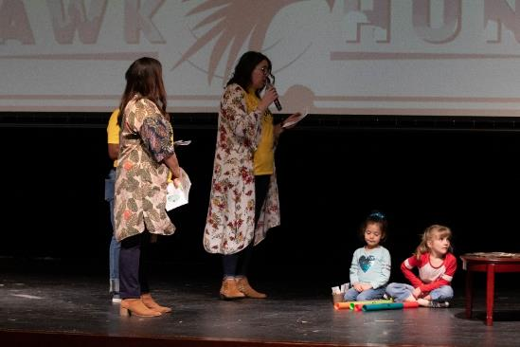
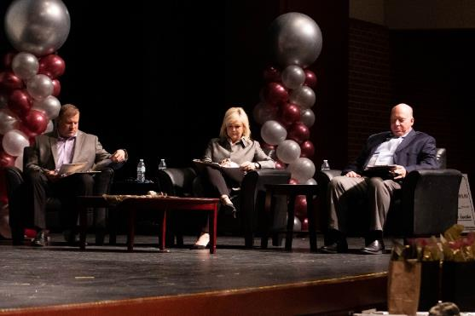
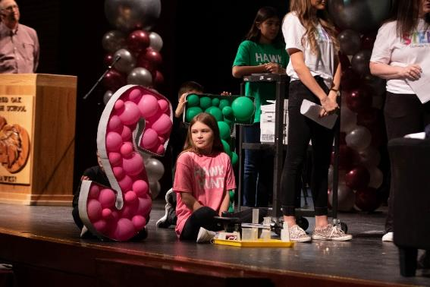
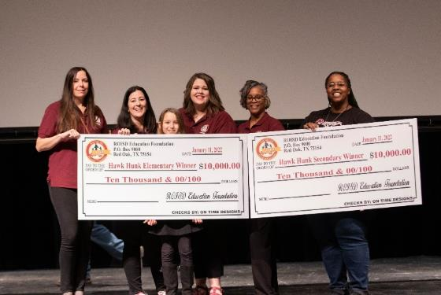
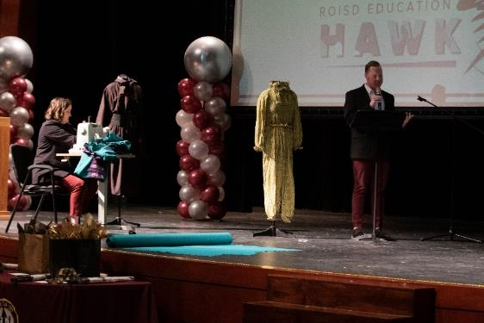
Solution for 2021 Surplus

Slide 12
FOR KIDS FOR TOMORROW
40,000 Students Approximately
33 Elementary Campuses / 10 Middle School / 6 High School / 2 Alternative Campuses
Established in 2004 - 18th Year
1 Full-Time ED / 1 Full-Time Secretary / 25 Board Members

Slide 13
GRANT FUNDING CATEGORIES
Innovation
Grants
Campus
Grants
$10,000 - $15,000
Grants
Max $3.00 per student
or Min $2,000 Grants

Slide 14
Recent Grant Funding History
 | Applications | Funded | Amount
2016-17 | 102 | 56 | $214,840.00 | Categories changed
2017-18 | 86 | 34 | $253,618.00
2018-19 | 83 | 35 | $249,333.00
2019-20 | 45 | 32 | $250,490.00
*2020-21 | 66 | 36 | $202,693.00 | *COVID - Reduced Budget
*2021-22 | 30 | 27 | $163,018.00 | *COVID - Reduced Budget
2022-23 | 67 | TBD | TBD

Slide 15
Trends in Mesquite ISD
2016-17 – Large increase due to new INNOVATION GRANT category.
2017-2019 – Expected decrease. Perceived less chance to get selected??
2019-20 – Major district initiatives and administrator/teacher capacity stressed. Principals can drive the response.
AYO
Holdsworth Leading Through Ownership Initiative
Local Accreditation System
Leadership & Empowerment
Read-Play-Talk.
Campus staff shortages.
Recently, campuses have had access to more funds than normal. (Not Esser Funds)

Slide 16
Grants Program
April 6, 2022
Mita Havlick, Executive Director

Slide 17
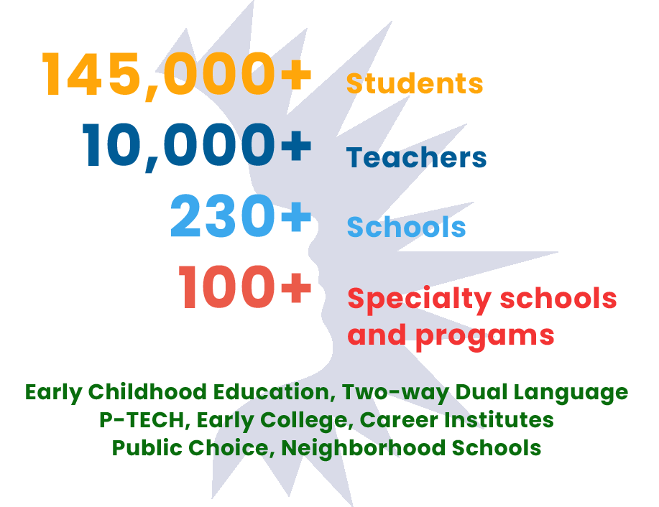
Dallas ISD and Funding Trends
Dallas ISD
District of Infinite Need
Increase in funding opportunities
Hyper-focus on equity-driven initiatives
Attempt to make an impact on a larger scale
85% of our students are economically challenged

Slide 18
Types of Foundation-funded Grants
Pass-through
Restricted / little discretion
Direct to Dallas ISD
Discretionary
Collaborative
In partnership with outside agency with Dallas ISD as end beneficiary
Direct to Dallas ISD... OR
Alignment with district’s strategic initiatives

Slide 19
Discretionary Grants
Direct to ISD
Interest
Pursuit
Fund
Solicit ISD interest of grant opportunity
Form grant pursuit team
Pursue grant
Receive funding
Receive signed donor agreement
Fund program
Direct to Partner Agency
Publish
Receive
Review - grants committee
Award
Post Letter of inquiry (LOI)
Direct to partner agencies
Review LOIs
Vet and invite to submit full application
Review applications
Complete rubric
Perform site visit
Signed agreement
Disburse funds
(PROPOSED)

Slide 20
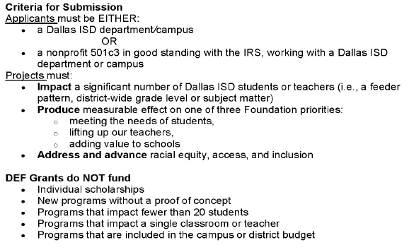
Partner Agency Rules of Engagement

Slide 21
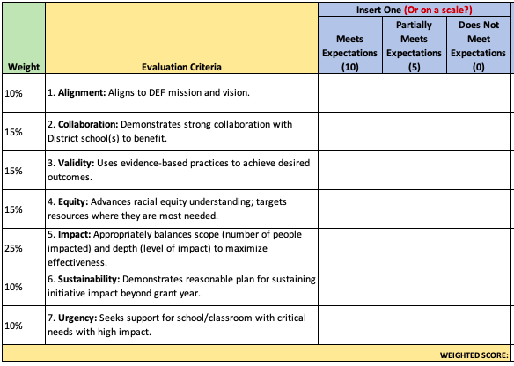
Success Requires Solid Documentation
Weighted rubric for application evaluation
Three-way agreement between foundation, partner agency, and ISD
Include the appropriate T&C’s:
Amount
Purpose
Expend by date
Reporting requirements
Reviewed by Legal
Ensure accountability
Measure impact
Have a solid audit trail

Slide 22
Mita Havlick
Listen
&
share
Randy Lewallyn
Karen Anderson

Slide 23
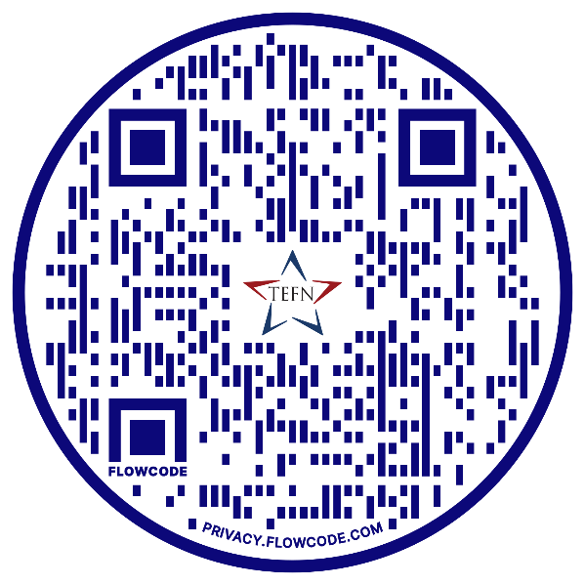
Contact Us
With questions
Mita Havlick
Randy Lewallyn
Karen Anderson

