Slide 1
“Hey Guys!”
Wow Them With an Impressive Social Media Presence
TEFN Annual Conference
Monday, April 5, 2022

Slide 2
Your Brand’s Social Media Profiles
“Your brand is what other people say about you when you’re not in the room.”--Jeff Bezos, Amazon
Notes:
We are nonprofits yes, but when it comes to branding, approach it like any other company or business.

Slide 3
Be Real. Be Honest.
Notes:
“Speak Human on the Internet” Let your social media profiles reflect your brand and the “personality” of your organization.

Slide 4
Branding: Who Are You?
Brand Personality:
Brand personality refers to the set of human characteristics or traits that can be associated with a brand (Aaker, 1997).
Brand personality gives consumers something with which they can relate to which effectively increases brand awareness, popularity and brand loyalty.
By establishing a brand personality, businesses can form emotional bonds with their consumers.

Slide 5
Nekter Juice Bar

Slide 6
1 in 3 Foundation
Brand Values:
Compassion
Sympathy
Care
Respectful
Honest
Responsive
Notes:
Images, diversity of who we are and who we serve. Tell me some traits you would use for your education foundation?

Slide 8
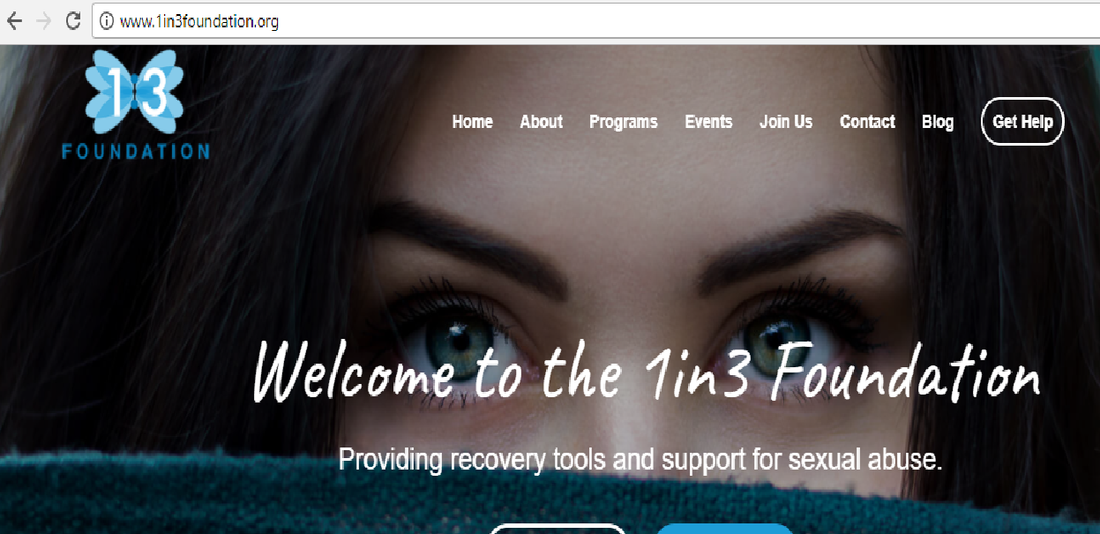
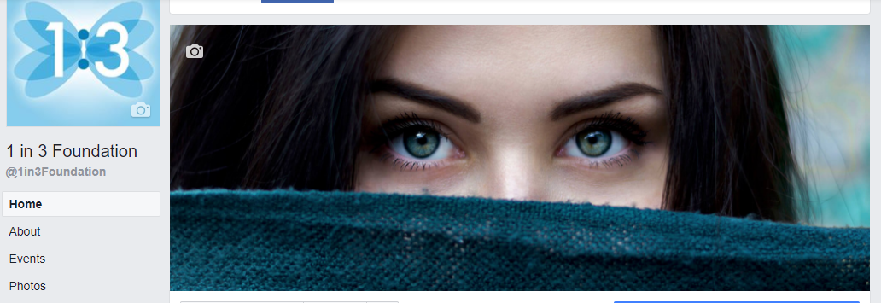
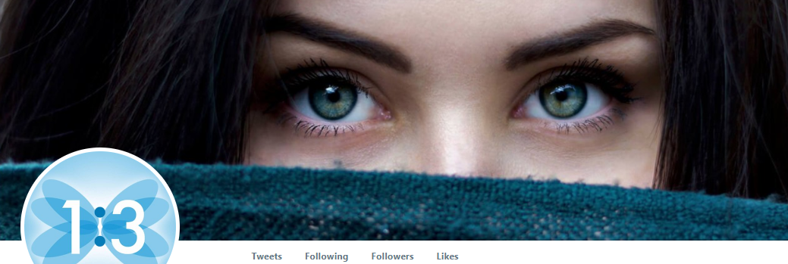

Slide 9
An Effective Social Media Presence
Where can they find you?
Website
Facebook
Twitter
Instagram
LinkedIn
Snapchat
YouTube
Pinterest
Notes:
Once you know what your brand represents and “who” you are, where can you be found? What fits best for your organization and available time? If I google you and you don’t come up, you don’t exist. Many of you do not have Twitter. Does your district?

Slide 10
Socialnomics

Slide 11
Social Media Plan of Action

Slide 12
Do’s
Brand Consistency
Your Brand Colors
Your Event Colors (Consistent with Brand or Theme)
Theme of Your Logo (Star, Crown, Apple)
Notes:
Presentation is all in blue and white, subliminal 1 in 3 Foundation marketing

Slide 13
Do’s
Create a Social Media Calendar
-Foundation Events
-Holidays
-School District Events
-”Quirky Days”
-Hashtag Days (#MondayMotivation, #TBT)
Notes:
#TBT To your grant patrol or gala

Slide 14
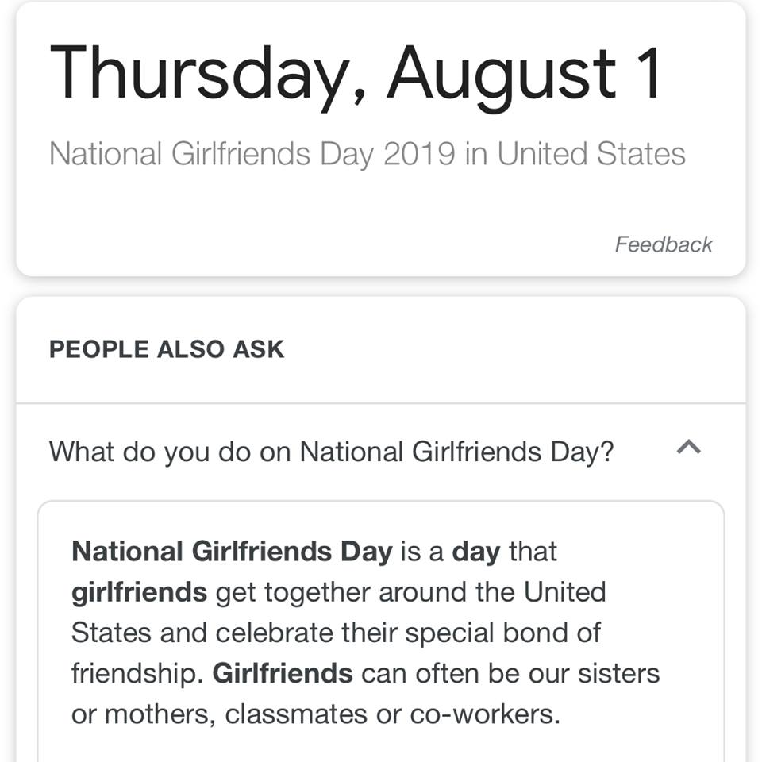
Notes:
Galentine’s National GFs Day, Branded in our colors. Consider International Dog Day-Spotlight Service Dogs in your District or a grant for animals (K9 Grant)

Slide 15
“Never Enough Time”
Schedule Your Posts
Facebook
Hootsuite
Graphically Challenged?
Canva
Adobe Spark (for Educators)

Slide 16
Special Event Promotions
Profile Pictures
Page Headers
Create an Event Page (Facebook)

Slide 17
Notes:
Purple for DV Awareness

Slide 18
Ads & Campaigns
Ads can reach a broader audience than your followers
“Create Audience” then choose “Custom Audience”
Custom Audiences allows advertisers to target those who have already expressed interest in their business.
Upload Contacts
Target a specific profession, gender, age group, location with your ad
Select length of promotion
Notes:
Google for nonprofits give you free ad space

Slide 19
Best Times to Schedule Posts
Prioritize Your Posts
Don’t bury Event & Program Announcements under other posts

Slide 20
Best Times to Schedule Posts
Facebook
Best times to post to Facebook: Wednesday at 11 a.m. and 1 p.m.
Best day: Wednesday is the best day to post on Facebook.
Most consistent engagement: Weekdays from 9 a.m.–3 p.m.
Worst day: Sunday has the least amount of engagement for Facebook during the week.
Lowest engagement: Early mornings and evenings, before 7 a.m. and after 5 p.m. have the least amount of engagement per day.
Sproutsocial.com

Slide 21
Best Times to Schedule Posts
Twitter
Best times to post on Twitter: Wednesday at 9 a.m. and Friday at 9 a.m.
Best days: Tuesday and Wednesday are the best days to post on Twitter.
Most consistent engagement: Monday through Friday from 8 a.m.–4 p.m.
Worst day: Saturday gets the least engagement.
Lowest engagement: Occurs every day from 10 p.m–4 a.m.
Sproutsocial.com

Slide 22
Best Times to Schedule Posts
Instagram
Best times to post on Instagram: Wednesday at 11 a.m. and Friday at 10–11 a.m.
Best day: Wednesday is the overall best day to post to Instagram
Most consistent engagement: Tuesday through Friday, 10 a.m–3 p.m.
Worst day: Sunday receives the least amount of engagement on Instagram
Lowest engagement: Occurs during late night and early morning from 11 p.m.–3 a.m.
Sproutsocial.com

Slide 23
“I hear you knocking, but you can’t come in.”
Tagging
Is the district tagging you in photos?
Do you tag the district and staff in photos?
Do you respond to tags? Share? Comment? Like?
Stakeholders can see your interactions or lack thereof
Treat your Facebook page as you would your personal page.

Slide 24
Questions?
Maya Golden Bethany
Executive Director, 1 in 3 Foundation
info@1in3foundation.org
(903) 881-3091 ext. 1

